Slide 1

A Clear Future For Libbey Inc.
Harnessing direct selling to achieve sustainable growth in Indonesia
Presented by:
Trip Burke, Charlie Deng, Priya Khanna, Catherine Miller, Wade Oakley, and Bill Su

Slide 2
Executive Summary
Libbey Inc. has an excellent opportunity to expand its business in Indonesia by harnessing direct selling channels and positioning its brand as both trustworthy and aspirational
Libbey is well equipped and ready for growth
Libbey has 6 distinctive brands selling through 3 channels in over 100 countries
This leaves the company with extensive experience serving a very wide range of customers
Libbey has stable cash flows and high debt capacity of $82 Million, so it is financially qualified for expansion
Its flexible business model is capable of adapting to receptive new markets
Indonesia is an attractive market for Libbey Inc.
Disposable income in Indonesia is steadily growing
Its banking system is strengthening, resulting in lower borrowing risk and increasing business capacity
Indonesians have a tradition of homeware gifting and tend to overspend on aspirational products to display their affluence
Indonesians trust global brands

Slide 3
Executive Summary
Libbey will penetrate the Indonesian market through a Joint Venture with a local direct selling firm
Together, the two firms will harness their social networks to better understand the Indonesian market, introduce Libbey products, and grow Libbey’s brand recognition
Libbey will manage product orders, distribution of logistics, and overall strategic management of the company, including branding and product positioning
The local direct selling partner will manage Marketing, Advertising, and Human Resource functions and will work closely with Libbey expats in a shared Indonesian office
Libbey and its partner will employ unique customer feedback collection and analysis to create an agile marketing and selling strategy
Pending a successful negotiation with the firm, Libbey will receive 60% of profits in this market
By organically building the Libbey brand , Libbey can profitably capture significant market share
The Libbey brand name will grow through word of mouth advertising
Libbey’s enhanced reputation will lead to successful growth of an eCommerce platform
Ideally, Libbey will profitably capture 10% of the market with a salesforce of over 1,500 and sales of 200M IDR per salesperson, growing at a steady pace
Success in the Indonesian market will enable Libbey to expand across channels and into other Asian Pacific countries
Considering best, base, and worst case scenarios, the NPV of entry is $16 Million

Slide 4
Table of Contents
Libbey Glass Overview
As-Is Business Model Canvas
Product Portfolio
Indonesian Market Analysis
Market Selection
Country Overview
CAGE Analysis
Porter’s Five Forces Analysis
Institutional Voids
Market Entrance Strategy
Strategy Overview
To-Be Business Model Canvas
Detailed Strategic Plan
Partnership Details and Potential Partners
Libbey To-Be Process Model
STP Map
4P Analysis
LBGUPS
Abandonment Criteria
Financial Analysis
Cost and Revenue Models
Base-case DCF
NPV of Entry and Scenario Criteria
Risk Analysis
Appendix
Works Cited
1
2
3
4
5
7
8
9
10
11
14
16
17
18
20
21
22
23
24
25
i
ii

Slide 5
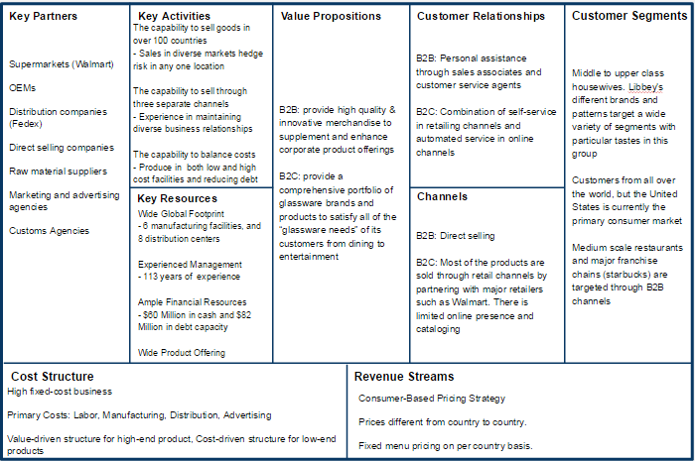
Libbey Glass is a company that exemplifies variety, internationality, flexibility, and success
Variety
Flexibility
Libbey designs and markets six extensive lines of high-quality glass tableware, ceramic dinnerware, metal flatware, hollowware, and serveware.
Libbey sells its products through three distinct channels internationally, and is therefore able to adapt to each country’s unique needs.
“As-Is” Business Model Canvas
In order to fully realize the potential of all product lines, it must seek to enter larger markets.
To utilize this advantage of flexibility, Libbey must continuously expand to countries with revenue opportunities.
Internationality
Success
Libbey already has a significant international presence, with manufacturing facilities in China, Mexico, and United States. Its products are sold in over 100 countries.
Its net sales have been steady over the past five years, it pays regular dividends, has cash reserves of $60M and a debt capacity of $82M.
But Libbey can reap higher returns by digging into a new market and becoming a sizeable player there.
In order to achieve its target annual growth rate of 4-6%, it must expand.
1

Slide 6







Of Libbey Inc.’s product portfolio, Libbey Glassware, Syracuse China, and World Tableware are the most adaptable
Brand
Products
Target Segment
Adaptability
Glass tableware, including wine glass, jars, and other household glassware
Households or restaurants seeking high-equality glass products
This brand is well-equipped to adapt to most developing markets around the world due to low manufacturing cost and worldwide manufacturing
Ceramic tableware such as plates and bowls
Households seeking high performance ceramic tableware
This brand is well-equipped to adapt to most developing markets around the world. However, it is currently only manufactured in China and in the U.S.
Comprehensive tableware products of all materials
Restaurants seeking comprehensive tableware solution
This brand is well-equipped to adapt to most developing markets around the world due to low manufacturing costs and high global coverage
Quality German Stemware and Wine Glass
Households or restaurants seeking high-end glassware
This brand is not well-equipped to adapt to developing markets due to high manufacturing costs and price
Stainless steel and silverplated flatware and serveware
High-end restaurants or households seeking high-end serveware
This brand is not well-equipped to adapt to developing markets due to high manufacturing costs and price
Creative and durable ceramic dinnerware
High-end restaurants or households seeking high-end tableware
This brand is not well-equipped to adapt to developing markets due to high manufacturing costs and price
Luxurious Bavarian crystal, serveware, and drinkware
High-end restaurants or households seeking high-end, elegant glassware
This brand is not well-equipped to adapt to developing markets due to high manufacturing costs and price
2

Slide 7
Indonesia is the most attractive market in Southeast Asia compared to other viable options
Libbey Should Expand
In Asia Pacific
Libbey has expressed interest in increasing its market share in China and Asia Pacific and already has manufacturing facilities in China.
Libbey primarily sells to wholesalers and distributors in Asia Pacific, reflecting a major opportunity to further penetrate this market and increase its presence.
Libbey Should Focus On
Southeast Asia
Many Southeast Asian countries are growing at astonishing rates and their homeware markets are relatively unsaturated.
Business in China is facing significant difficulties, leaving Vietnam, Malaysia, the Philippines and Indonesia as the top potential markets for Libbey.
Libbey Should Enter the
Indonesian Homewares Market
Indonesia has both relatively low import costs and relatively low inspection rates in port relative to other Southeast Asian countries.
Indonesia has better prospects for economic success than Vietnam and Philippines, particularly with high-end products, with its higher GDP per capita and disposable income.
Indonesia’s homewares market is bigger and less concentrated than that of other countries - The top 5 firms in the market only control 30% of the market. For example, Malaysia is particularly consolidated (Tupperware controls 25% of market).
3

Slide 8
Indonesia is a emerging market with a high economic growth rate, large population, and stable governmental structure
Indonesia is the world's third most populous democracy, the world's largest archipelagic state, and the world's largest Muslim-majority nation.
Demographic
Economy
Government
Indonesia has a population of 255.21 million people, it is the 4th largest country in the world by population, and largest Muslim nation in the world.
Its population has been growing continuously, creating more middle-class customers that Libbey could potentially target in the future.
More than 50% of the population lives in rural areas. The agriculture industry is therefore a huge employer and perceived as a national champion industry.
There are a large number of ethnic groups present, each with its own culture.
The 2014 GDP for Indonesia is $2.554 Trillion, making it the 9th largest economy in the world. The GDP has been growing at a rate higher than 5% continuously in the past few years, a rate higher than OECD average.
Its currency is Rupaiah, with exchange rate of 1 USD = 12,941 IDR. the currency have been depreciating in recent years primarily due to high inflation rate caused by economic growth.
68% of total consumer expenditure is attributed to the top four deciles. Only 4% of total consumer expenditure is attributed to the bottom two declies. This indicates large income disparity.
Indonesia is currently a constitutional democracy with a multi-party system. The current president is Joko Widodo, who is both the president of the state and the government.
There is limited separation of judicial, executive and legislative power within the government according to the 1945 constitution. The court, president, and parliament each have significant power.
A decentralization movement in 2001 prompted regencies and municipalities are the primary sources of administrative power.
4

Slide 9
Indonesia’s cultural environment and positive economic prospects will drive Libbey Inc.’s success
C A G E
Macroeconomic Trends
Microeconomic Trends
Rapid economic growth (6th largest economy by 2020)
Rising middle class leads to increasing annual disposable income and consumer spending
Annual Disposable Income Year-on-year Growth rate: average over 5% for the next 5 years
Capital markets are becoming more transparent, but compliance with national and international law is slow
Banking system is sound and interest rate spreads are the highest in the region
Payment options are wide and not too risky
Indonesian homeware industry is expected to grow 35% over the next 4 years
Five largest firms control only 29.9% of market and the homewares market is not yet saturated
Annual growth in consumer expenditure on homeware consumption from 2014 through 2018 is over 6%
Indonesian homewares industry is expected to have a market size of $2.8 billion by 2018
Oven sales have increased by 86% over the past 5 years, presenting opportunities to tap into this market
Economic
Distance is
Decreasing
Proven Success of Foreign Brands
Prevalence of Gifting
Desire to Appear Affluent
Tea’s Important Role in Indonesian Culture
The significance of tea in the Indonesian culture encourages the growth of the homeware market with increased beverageware consumption
Indonesians have a tradition of gifting
Homewares are a popular choice for wedding and housewarming gifts
Over a quarter of Indonesian consumers spend more money than they earn
Tend to purchase decorative products to appear affluent
Spend more on arisan (social gatherings)
Preference for globally recognized brands
Gifting is a consequence of the communal nature of the country and the prevalence of social networks
Similar global homewares firms like Tupperware have achieved success in this market already
Intellectual hurdle has already been cleared
Trend unlikely to decrease over time
Cultural Distance is Low
5

Slide 10
Administrative bureaucracy and poor infrastructure are counterbalanced by openness and geographic proximity
C A G E
Administrative and Geographic Distances are Moderate
Bureaucracy and Local Favoritism
Time consuming bureaucracy caused Indonesia to rank 128 out of 185 countries in the Ease of Doing Business 2013 report by the World Bank.
Conflicting laws and poor court dispute settlement leads to IP issues
Personal connections are often more highly valued and honored than formal contracts
Poor Internal Infrastructure
Indonesia has poor internal infrastructure – including underdeveloped roads, telecommunications, electricity, other services. These factors increase geographic distance because it makes internal transportation difficult.
In future stages of expansion, Libbey will need to develop a multi-hub logistic approach rather than a wheel and spoke approach as transportation costs rise.
Lack of telecommunication infrastructure makes increasing country-wide brand awareness more difficult
Counterbalanced by:
Administrative Openness
Finished goods will primarily be shipped from China to Indonesia because Libbey has a manufacturing facility located in Langfang, China.
Indonesia and China are both part of the China-ASEAN Free Trade Area and both enjoy lower tariffs. By shipping from China, Libbey will save on transportation costs.
The U.S.-Indonesia Comprehensive Partnership, inaugurated in 2010, has promoted high-level communication about democracy and civil society, education, security, climate, maritime, energy, and trade issues between the two countries.
Counterbalanced by:
Geographic Proximity
Langfang, where Libbey’s manufacturing facility is located, is much closer to Indonesia than any of their factories in the United States, Mexico, or Europe.
Libbey will first enter the Indonesian market through Jakarta, a port city. The port to port connection between Langfang (near Tianjin) and Jakarta will great reduce supply chain length and logistic complication.
6

Slide 11
The Indonesian homeware market is moderately attractive but buyer power and threat of new entrants are increasing
Industry Definition: Homewares (including tableware, glassware, kitchenware, flatware, and food storage)
Threat of Substitutes - Low, constant
Homewares remain a basic necessity for households in all income groups
Tableware in particular has an attractive price-performance tradeoff that is unlikely to be offset by substitutes
Homewares likely to remain a popular gift item over the coming years
Buyer Power - Moderate to high, increasing
The market is fragmented without a dominating player
Homeware consumption is becoming a larger part of consumer budgets
Buyers have low switching costs/little brand loyalty
Products made from the same material are not very differentiated
Industry Rivalry- Moderate, constant
High fixed costs from manufacturing
Low product differentiation between goods made from the same material
Industry is fragmented with top five firms holding 30% of the market
Industry will grow more slowly over next five years
Threat of New Entrants – Moderate, increasing
Significant capital requirements for manufacturing and maintenance
Low expected retaliation from major players, given the fragmentation of the market
The market is attractive to new entrants, given favorable growth trends
Supplier Power- Moderate to low, constant
Collective bargaining contracts result in higher wages
Increasing fuel and energy costs
Raw materials are available in adequate quantities from multiple sources
Steady raw material prices
*Supplier definition: labor (research & development, manufacturing and transportation), raw material and energy (sand, lime, soda ash, corrugated packaging and colorants)
7

Slide 12
Indonesian institutional voids are manageable with an adapted strategy
- Quite difficult to conduct business - ranks 128 out of 185 on ‘ease of business’
- Must use a local agent and need extensive documentation before importing
- Wages have increased 44% in Jakarta
- Lack of great education system
- Severance pay is high for dismissed employees and local courts side with local citizens in labor disputes
Political & Social Systems
Product Markets
Capital Markets
Labor Markets
Openness
- Laws can be opaque and conflicting - Paperwork process takes a long time
- Can be difficult to terminate a bad relationship
- Local firms heavily favored in dispute settlement
- Communal society emphasizes relationships over formal agreements
- Infrastructure is severely lacking- expensive to ship products long distances
- Need to redesign packages to have Indonesian writing (in Latin letters) and Arabic numbers
- Becoming more transparent, but compliance with national and international law is slow
- Banking system is sound and interest rate spreads are the highest in the region
8

Slide 13
Libbey Inc. will employ an Adaptation strategy to understand and penetrate the higher-income market segment
Stage 1 (1-2 Years)
Libbey will enter a joint venture with a local direct selling firm.
Stage 2 (3-5 Years)
Libbey will push its eCommerce platform as its brand recognition and customer base grows.
Libbey will introduce ceramics and holloware to the market.
Stage 3 (>5 Years)
Libbey can introduce new product lines to the market.
Together, the firms will penetrate the Indonesian market (primarily Jakarta) through social networks and selling parties.
Only glassware products will be introduced in the first stage.
Products will be manufactured in China.
Warehousing and distribution will be outsourced to DHL.
Libbey will launch an eCommerce platform and pilot test it while demand is low and growing.
Libbey can open showcase stores in major cities.
Libbey can expand to B2B.
Libbey can expand to similar attractive markets.
Libbey will develop mobile applications to make ordering easy.
Libbey will continue to tap into social networks, both in-person through direct selling and online through social media.
Goals:
Recruit at least 150 committed sales reps through Year 1 launch parties
Build brand name through word of mouth
Average sales per rep >150 million IDR by Year 2
Goals:
Grow eCommerce platform to represent at least 5% of total sales
Continue sales force growth on track with projections (see Appendix)
5% market share in glassware market by end of Year 5
Average sales per rep >187 million IDR by Year 5
Goals:
Develop B2B direct sales team
Target two countries for similar expansion
Become a top 5 glassware player through continued sales force growth
Greater than 10% market share of glassware market by Year 7
Average sales per rep >200 million IDR by Year 7
9

Slide 14
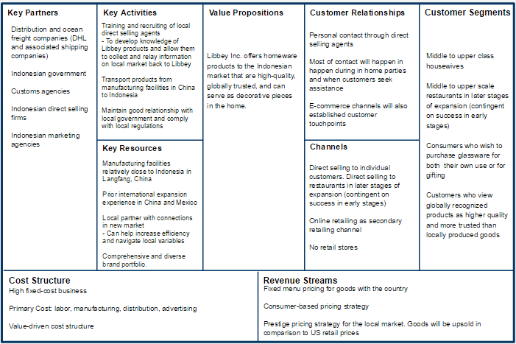
Libbey will alter key processes of its BMC to adapt to the Indonesian Market
“To-Be” Business Model Canvas
CRM will become more intimate
Creating partnerships with companies in various steps of the value chain is crucial to Libbey’s business model adaptation
The new customer segment will be more focused on higher end customers
Direct selling will be the primary distribution channel. Retail presence will be phased out
10

Slide 15



Libbey will make key process adaptations to penetrate the Indonesian market
Stage 1
In order to redefine and amplify its brand among the desired higher-income market segment, Libbey will need to taper off its retail presence in Indonesia and redirect all sales through the direct selling channel by entering a joint venture with an Indonesian direct selling firm to re-launch its brand in the market.
Setup
Logistics
Marketing
For the first 1-2 years, Libbey will work primarily in Jakarta with the direct selling firm to introduce its higher-end glassware lines to the market, build up its brand recognition, and better understand the Indonesian consumer.
Libbey will set up an office in Indonesia, and will come up with integrated corporate, marketing and sales processes with its joint venture partner to ensure simultaneous selling and learning.
Products will be manufactured in China, and distribution & warehousing will be outsourced to DHL.
Only high-end product lines already being manufactured in China will be sold, that include glass tableware, ovenware, and food storage products.
DHL will employ shared warehousing and cross-docking to reduce handling and carrying costs while demand for Libbey products is still low and growing.
Libbey will focus on top 40% of Indonesian consumers, as 68% of total expenditure in Indonesia is attributed to this segment.
Libbey will focus its selling efforts on penetrating social networks through sales parties and other personal selling tactics.
Libbey will also launch an eCommerce platform during this stage while demand is still low and growing, to allow for early testing and modifications.
11

Slide 16
Libbey will push eCommerce as its brand grows
Stage 2
After 2 years, Indonesian customers will trust the Libbey brand and appreciate its value. Libbey will capitalize on this trust by pushing its customers to its eCommerce platform, thus increasing volume of sales and geographical reach of sales.
Libbey will continue to market to social networks and selling parties.
As internet usage and eCommerce grow in Indonesia, Libbey sales will expand beyond direct selling via parties with online social sharing.
Libbey will introduce ceramics and holloware product lines to the market.
Libbey will employ mobile applications to make ordering Libbey products easy and accessible.
Libbey will use online promotions and localized “Own the Moment” messaging to portray Libbey as a global company that values Indonesian traditions, thus fitting Indonesian sentiments about foreign vs. local firms.
Timing is key - by pushing its eCommerce platform as eCommerce begins to expand in Indonesia, Libbey will portray itself as a cutting-edge firm.
12

Slide 17
Libbey can further adapt and aggregate across channels and countries in the long run
Stage 3
In the long run (beyond our 5 year financial forecasts) Libbey will assess its success in the Indonesian market to determine next steps.
If there is sufficient demand and if geographic and administrative distances improve, Libbey could open showcase stores in urban areas.
If Libbey feels that it can successfully differentiate its brands in the minds of Indonesian consumers, it could expand to B2B.
Libbey could introduce ceramics and holloware lines and consider a multi-hub approach to serve each city, rather than a hub and spoke strategy
If profits and ease-of-business in Indonesia turn positive, Libbey should consider similar adaptation to aggregation strategies in similar markets. Malaysia and Vietnam are two similar attractive markets, but like Indonesia, would require localized approaches for success.
Libbey must work closely with its local marketing offices to ensure that its brands do not jeopardize each other.
13

Slide 18
Entering a JV with leading direct selling firm will enable Libbey to successfully enter and navigate the Indonesian market
Logic of the Joint Venture
Joint Venture Structure
Entering a joint venture with an Indonesian direct selling firm will position both Libbey and its partner for learning and long term growth.
The joint venture will entail going beyond simply hiring the direct selling firm.
The direct selling firm will not only manage day to day selling operations, but will also provide perspective on emerging market trends and technologies based on their field experience.
The JV will require significant collaboration.
Libbey and the direct selling firm will work together to define goals and integrate operating processes for the duration of this project. This will result in efficient use of shared resources and expanded R&D capabilities.
Both parties will benefit.
With the direct selling firm, Libbey will be able to accelerate its market penetration and brand growth.
With this experience of helping a global firm enter a new market by adapting to local needs, the direct selling firm will be more attractive to future employers and partners.
Assuming contract negotiations go as planned, 40% of Libbey Indonesia profits will be given to the direct selling firm to ensure alignment of incentives and effort.
Libbey will set up an office in Jakarta, Indonesia.
Two expatriates with prior international expansion experience selected by Libbey Corporate will be sent to the Jakarta office, including an expansion manager and a rising star as the head of the Indonesia office.
Libbey will control product orders, distribution, and logistics (aided by its relationship with DHL), and overall strategic management of the corporation including branding and product positioning.
The direct selling firm will control the human resource function (salespeople), advertising, and market research.
In stage 1 of this strategy, the firm will employ unique customer feedback collection and analysis to create an agile marketing and selling strategy
The JV contract will be reevaluated every 2 years, according to progress benchmarks.
14

Slide 19
Zhulian Marketing is an ideal candidate for a JV partner, followed by Elken and QNET
ZHULIAN
Founded in 1989 in Malaysia
Sells a wide range of products, but none in the homeware market
ELKEN
Established in 1995
QNET
Founded in 1998
Primarily sells in Malaysia, Indonesia, Singapore, & Thailand – relatively focused geographical scope
Has experienced rapid growth since 2012 – listed under Forbes Asia’s 200 Best Under A Billion in 2013
Started off selling jewelry – has experience with selling higher-end products to the middle-upper class
Sells in 6 Asian Pacific countries including Hong Kong, India, Thailand, Indonesia, Brunei and Singapore – moderately focused geographical scope
Ranked 50 in the Top 100 Revenue-Generating Direct Selling Companies Worldwide in 2013
Has 5 branches in Indonesia
Sells homeware, but not luxury homeware
Focused on expanding geographical scope
Selling in 100 countries – wide geographical scope
Is the leading direct selling firm in Indonesia- offices in Jakarta, Bali, and Surabaya
Was one of the first Asian companies to push network marketing online – has a successful mobile app for its salespeople and customers
Sells a wide variety of goods, including homeware and houseware
Focus on development of salespeople, rather than client business
 | ZHULIAN | ELKEN | QNET
Ideal Geographic Scope | ★★★ | ★ | ★★
Experience (specifically in Indonesia) | ★ | ★★ | ★★★
Willingness to Accept Incentives | ★★★ | ★★ | ★
Lack of Competing Products | ★★★ | ★★ | ★
Likely Interest in Libbey | ★★★ | ★★ | ★
(Rankings are relative to each other; 3 stars = most favorable, 1 star = least favorable.)
15

Slide 20
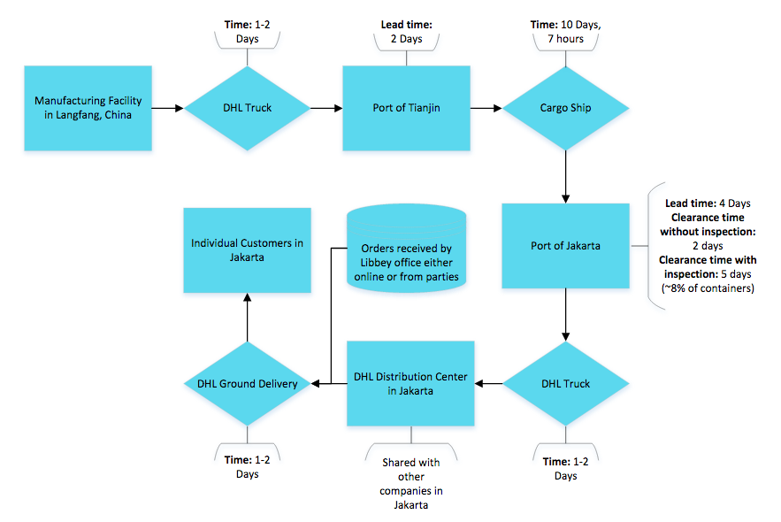
Collaboration with DHL and local partners will foster efficient transportation logistics and distribution
Best case supply line length: 17 days
Worst case supply line length: 23 days
Langfang, China is only a two hour drive from the port of Tianjin in Northern China. However, due to potential traffic and the times it takes to load and unload containers onto trucks, the time of transportation between the Libbey China plant and the Port of Tianjin is estimated at 1-2 days. This assumption is applied to each stage of ground transportation
Dependent on traffic conditions and time to load and unload containers
These are fixed time constraints
Goods will be transported from the port to a DHL warehouse and distribution center that Libbey will share with other companies to decrease costs.
Once orders are received for Libbey goods by the local Libbey office, DHL will deliver these goods to individual customers in Jakarta via ground transportation. Because the first stage of operations will only occur in Jakarta, delivery time from the centrally located distribution center will be short (about 1-2 days on average) but still subject to the same traffic and time risks.
With the help of DHL logistics, Libbey should be able to handle inventory levels in Indonesia in stage 1 using sales predictions and market research. After stage 1, Libbey and DHL will have a much better idea of product demand, sales growth, and inventory management.
Biggest risk is whether our goods will be stopped for inspection after arriving in port. Harnessing local relationships can help eliminate this risk and keep supply line short
While many of these transition points in the process model create opportunities for additional costs, our partnership with DHL will limit attempts at bribery, waiting periods, and inspection.
Dependent on traffic conditions and time to load and unload containers
16

Slide 21
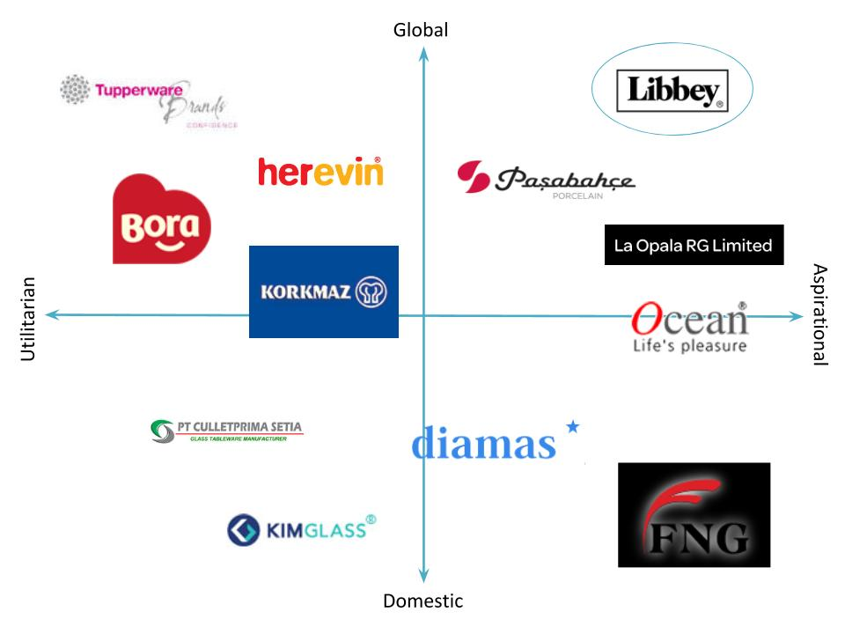
Libbey Inc. should position itself as a global brand that offers aspirational and high-quality products
Libbey’s competitors in the Indonesian homewares market are positioned along two continuous spectrums: ‘Global and Domestic’, and ‘Utilitarian and Aspirational’. There is a clear gap in the market in the upper right-hand corner. Given that Libbey produces high-end glassware and is a global firm, it perfectly fills this void.
The Majority of Libbey’s competitors in Indonesia are global brands from Turkey, Europe, or India.
Libbey’s key to success lies in marketing and positioning itself both as a globally recognized brand and a producer of high-quality, aspirational products. Indonesians are attracted to global brands because they are perceived as reliable and safe. They are also attracted to aspirational brands because they enjoy appearing affluent in their social circles.
Libbey’s Local Customer Value Proposition would therefore be the following:
Libbey Inc. offers homeware products to the Indonesian market that are high-quality, globally trusted, and can serve as decorative pieces in the home.
17

Slide 22
Libbey will introduce its glassware line in Indonesia and adopt a prestige pricing strategy
Prom
Place
Prod
Price
Product Mix
Promotion Campaign
Slogan → “Own the Moment”
Branding → Appeal to desire for luxury and exclusivity
Emphasize luxury products with Western appeal
Offer products that are both useful and stylish, and double as decorative pieces
Maintain the Libbey brand name because it already carries weight in these countries
Hire higher class sales agents to cater to high class friend groups - pay higher commission than Tupperware to compete and also attract the type of sellers we want
Advertising approach → Primarily word of mouth and in-home
Introduce products with in-home demonstrations
Articulate benefits of glass products over competitors
Eventually open showcase stores where consumers can browse expanded product offering
Use personal connections of sellers to offer special deals to friends who are about to move to a new house, have a wedding, etc.
Sell gift sets and bundled packages around major holidays and for wedding season
Hold launch parties to introduce Libbey as a direct selling product to both potential sellers and to future customers
Beverageware market has grown 65.3% over past 5 years
Dinnerware market has grown 54.3% over past 5 years
Oven sales have increased 86% over the past 5 years - although overall penetration is low at 2%, it is a great time for Libbey to enter for long-term revenue potential
Introduce glass product lines that are currently manufactured in China
Include glass tableware, ovenware, and food storage products in the product mix
Focus on product lines under the Libbey Glass Brand
Exclude alcohol related products from the market
Introduce other product lines manufactured in China (Syracuse China and Worldwide Tableware) as Libbey expands its Indonesian operations
Distribution Channel
Upon launching, Libbey will distribute its product through two primary channels – eCommerce and direct selling. However, in later stages, Libbey will create showrooms in major retail centers that display a larger set of Libbey products for purchase.
18

Slide 23

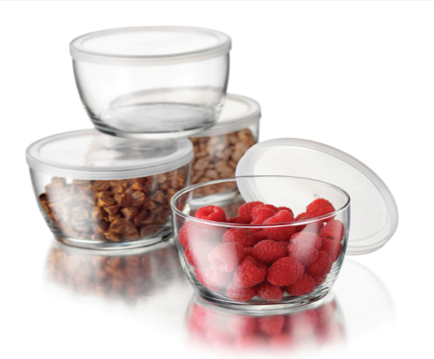
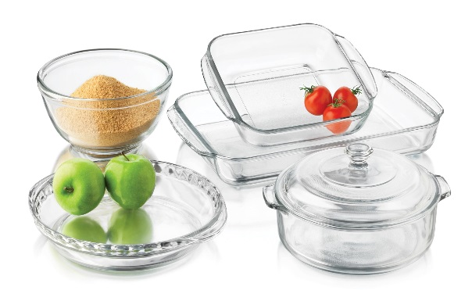
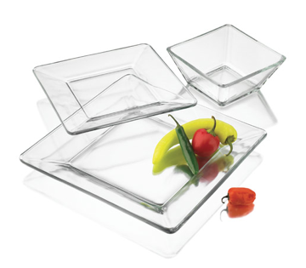
Libbey Inc. will pursue a prestige pricing strategy and upsell its glassware products in the Indonesian market
Prom
Place
Prod
Price
Pricing Strategy:
Libbey Inc. will pursue a prestige pricing strategy to support its aspirational branding and positioning strategy. The application of this strategy means that Libbey will upsell its products in the new market by adding a 60% markup to its US retail price.
The Indonesian consumer will ultimately pay even more for these goods due to there being a 10% value-added tax on top of the selling prices listed to the left. This value-added tax applies to almost every product in Indonesia.
The possible arbitrage opportunity driven by this increase in selling price is largely offset by import tariffs of 5% and transportation costs.
Libbey pursues this upselling strategy in other emerging markets as well. For example, Libbey products in China are marked up as much as 100-150%.
Carrington Clear Glassware (16 piece set)
Sold in the US for $21.99
With 60% markup, will sell for $35.19
Conversion: Rp 455,000
Glass Storage Bowls (4 piece set)
Sold in the US for $10.99
With 60% markup, will sell for $17.58
Conversion: Rp 230,000
Bake Set (11 piece set)
Sold in the US for $24.99
With 60% markup, will sell for $39.98
Conversion: Rp 520,000
Tempo Glass Dinnerware (12 piece set)
Sold in the US for $39.99
With 60% markup, will sell for $63.98
Conversion: Rp 830,000
19

Slide 24
Libbey’s adapted processes will cater to the Indonesian customer’s typical buying journey
Buying Stage
Libbey Process
Dependencies
LEARN
Word of mouth advertising through sales parties and social networks
Direct Selling firm, Salespeople
BUY
Place order with a Libbey salesperson, either at a party, online, or through a mobile application
GET
Libbey products are delivered directly to the customer via ground transportation from DHL warehouses in Jakarta
DHL
USE
PURCHASE
SERVICE
Libbey products are used for food/drink consumption or decoration
Cash or credit will be accepted
No repairs – customers can purchase new products as replacements
Salespeople, Libbey
Customers
Customers, Libbey, Banks
Customers
20

Slide 25
Low cost of abandonment decreases overall project risk
Stage 1 (1-2 Years)
Stage 2 (3-5 Years)
Short Term Exit Criteria:
Fail to find a direct selling partner for a joint venture
Less than 0.5% share of glassware market by end of Year 2
Launch parties are not successful (less than 5 salespeople per party)
Fewer than 100 sales reps by the end of Year 2
Average annual sales per rep less than 77 million IDR by end of Year 2
Average party sales are less than 4 million IDR
Stage 3 (>5 Years)
Medium Term:
eCommerce platform sales are less than 6.6 billion IDR by end of Year 4
Fewer than 500 sales reps by end of Year 5
Fail to expand beyond glassware
Average annual sales per rep less than 100 million IDR by end of Year 5
Less than 3% share of glassware market by end of Year 5
Long Term:
Growth in sales force <5% year over year (indicating market saturation)
Annual sales per rep fail to grow year over year
eCommerce platform sales fail to grow
Not in the top 5 glassware companies (by sales volume) by end of Year 7
Overall exit strategy if goals are not met:
End JV relationship with direct selling partner and take down eCommerce site
Ship remaining inventory back to warehouses in China for sale in other countries
Bring expats back to home market and end working relationship with local employees
21

Slide 26
Revenue is driven by sales force productivity, and costs are driven by commissions and expat pay
Revenue Model: Direct Selling and eCommerce
*Sales in IDR (millions), 1 million IDR = 77 USD (as of 4/20/15)
Year | Libbey Sales Force | Sales Per Rep | Direct Sales | eCommerce | Total Sales
1 | 158 | 153 | 24,217 | 0 | 24,217
2 | 249 | 161 | 40,119 | 0 | 40,119
3 | 393 | 169 | 66,462 | 6,646 | 73,108
4 | 620 | 178 | 110,103 | 7,975 | 118,079
5 | 978 | 187 | 182,401 | 9,571 | 191,972
6 | 1543 | 196 | 302,173 | 11,485 | 313,657
Assumptions:
-Ideal sales rep has 3 parties per month, with 6.46 million IDR in sales per party, so 232 million IDR in sales per year
-Starting at 66% sales capacity = 153 million IDR per year
-Sales rep growth is modeled after Tupperware sales force growth, starting with a much lower number of sellers (158 in year 1), see graphs
-eCommerce starts in Year 3 as 10% of direct sales and grows at 20% per year
Cost Breakdown for Year 1 |  |  |  | *In millions of IDR
Expats |  | 2 |  | Launch parties (Years 1 and 2)
Salary |  | 1,292 |  | Number of parties |  | 10
Benefits (70% salary) |  | 904 |  | Cost per party |  | 32
Total per expat |  | 2,196 |  | Total Cost |  | 323
Total cost |  | 4,393
 |  |  |  | Rent expense
Local Employees |  |  |  | Cost per square foot per year |  | 0.78
Number |  | 8 |  | Office size (sq. ft.) |  | 1000
Salary |  | 121 |  | Total Cost |  | 776
Benefits (60% salary) |  | 73
Total per employee |  | 193 |  | Marketing expense
Total cost |  | 1,548 |  | Promotions and giveaways |  | 129
 |  |  |  | Total Cost |  | 129
Commission to sales force
30% of sales
Summary of assumptions and yearly changes:
-Expat compensation increases by 4% annually
-Local employee compensation increases by 4% annually
-Rent expense increases by 4% annually
-Launch party expense increases by 4% in Year 2 (end of Launch Parties)
-Marketing expense grows by 2% annually (and most marketing is outsourced to direct selling partner, heavy reliance on word of mouth)
-Commission to sales force is 26% of their sales
-COGS is 64% of sales, includes tariff of 5% on glassware imports
Sources: COMM 3050 slides, MyExpatriate Pay for Indonesia, http://www.cushmanwakefield.com/~/media/global-reports/OSATW%202014%20Publication%20updated.pdf, KPMG Primer on Indonesian Value Added Tax
22

Slide 27
Base case DCF shows NPV of $13 million (IDR 172,509 million)
*Numbers in IDR millions
 | 2016 | 2017 | 2018 | 2019 | 2020 | 2021 | 2022
Revenue from direct selling | 24,217 | 40,119 | 66,462 | 110,103 | 182,401 | 302,173 | 308,216
Revenue from eCommerce |  |  | 6,646 | 7,975 | 9,571 | 11,485 | 11,714
Total Revenue | 24,217 | 40,119 | 73,108 | 118,079 | 191,972 | 313,657 | 319,930
COGS | 15,499 | 25,676 | 46,789 | 75,570 | 122,862 | 200,741 | 204,755
Gross Profit | 8,718 | 14,443 | 26,319 | 42,508 | 69,110 | 112,917 | 115,175
SGA
Commission to sellers | 6,296 | 10,431 | 17,280 | 28,627 | 47,424 | 78,565 | 80,136
Launch parties | 323 | 339 | 0 | 0 | 0 | 0 | 0
Expat compensation | 4,393 | 4,569 | 4,751 | 4,941 | 5,139 | 5,345 | 5,558
Local employee compensation | 1,548 | 1,610 | 1,674 | 1,741 | 1,811 | 1,883 | 1,959
Marketing expense | 129 | 132 | 134 | 137 | 140 | 143 | 146
Rent expense | 776 | 807 | 839 | 873 | 908 | 944 | 982
EBIT | -4,747 | -3,444 | 1,640 | 6,189 | 13,688 | 26,037 | 26,394
Taxes | -1,187 | -861 | -1,638 | 1,547 | 3,422 | 6,509 | 6,599
NOL Tax Asset | 1,187 | 2,048 | 0 | 0 | 0 | 0 | 0
Net Income / FCF | -4,747 | -3,444 | 3,278 | 4,642 | 10,266 | 287,040 | 19,796
WACC | 9.40% | PGR | 2% |  |  | Terminal Value | 267,512
Total NPV (IDR millions) | $172,509
NPV in USD (millions) | $13,352
Assumptions:
-See cost and revenue models for:
-Revenue from direct selling
-Revenue from eCommerce
-Base Year 1 costs
-Sales commission is 26%
-Launch parties run for 2 years
-Expat compensations grows 4% annually
-Marketing expense grows 2% annually
-Rent expense grows 4% annually
-Local employee compensation grows 4% annually
-NOL tax asset from losses can be used in Year 3
-Tax rate is 25%
-WACC = 9.4% (see Appendix)
-Perpetual growth rate = 2% -Entry starts in 2016
23

Slide 28
Considering best, base, and worst case scenarios, NPV of entry is $16 million
Case | Probability | NPV | Expected Value
Worst | 10% | -$3,713 | -$371
Base | 70% | $13,356 | $9,349
Best | 20% | $35,844 | $7,169
Sum |  |  | $16,147
In Perspective:
Libbey current market capitalization | $868,390,000
NPV of project | $16,147,000
60% share to Libbey in JV | $9,688,200
Contribution to Libbey's Value as % | 1.12%
*Dollar values in thousands
Scenario Criteria:
Base Case
Beta = 1.03 (industry averages)
WACC = 9.4% (see WACC calculations in Appendix)
eCommerce starts in 2018 at grows at 20% annually
Sales per representative start at $11,880 and grow 5% annually
Start with 158 sales reps in Year 1
Perpetual growth rate = 2%
COGS is 64% of sales
Best Case
Beta = 1.03 (industry averages)
WACC = 9.4% (see WACC calculations in Appendix)
eCommerce starts in 2018 at grows at 30% annually
Sales per representative start at $18,000 and grow 5% annually
Start with 158 sales reps in Year 1
Perpetual growth rate = 2%
COGS declines to 60% of sales
Worst Case
Beta = 1.03 (industry averages)
WACC = 9.4% (see WACC calculations in Appendix)
eCommerce starts in 2018 at grows at 20% annually
Sales per representative start at $6000 and grow 5% annually
Start with 158 sales reps in Year 1
Perpetual growth rate = 1%
COGS rises to 70% of sales
24

Slide 29



Major logistic risk,economic risk, and administrative risk might deter Libbey’s entrance
Logistic Risk
Economic Risk
Administrative Risk
Lack of infrastructure and complex logistics systems may affect inventory and product movements. Even though this risk is less apparent in initial stages of expansion, it increase cost for Libbey as the operation expands.
Lead times in port can significantly increase if our containers are stopped for inspection. Leveraging local relationships, without resorting to bribery, is the key to decreasing the chances for our goods to be stopped. Inspection also increases the chance of our goods being damaged in transit.
Wages are increasing in Indonesia. Therefore, Libbey might consider operational hedge to prevent economic exposure.
Plastics is the preferred material for homewares and Tupperware is a powerhouse in the direct selling arena.
While importing into Indonesia isn’t unreasonably expensive, the percentage of packages inspected are high (8%), which would lead to increase lead time.
Direct selling companies usually don’t engage in partnerships. Therefore, it would be difficult for Libbey to find qualified partners in Indonesia.
If partner doesn’t contribute to marketing expense, Libbey’s projected expenses will go up dramatically.
Local partners might serve as cultural gatekeepers and not offer Libbey full knowledge of the Indonesian market.
Even though there are risks associated with Libbey’s entrance to Indonesia, many of those risks can be reduced by hedging and risk pre-planning.
25

Slide 30
Libbey Inc. is subject to risks specifically associated with its Joint Venture entry strategy
Legal Risks
Ownership Issues
Legal courts in Indonesia tend to side with local companies in legal battles. Therefore, Libbey will need to have contingencies in the partnership contracts.
Mutual consent is required for contract annulment in Indonesia, so Libbey must include contingency clauses in the paperwork to protect its operational and governance powers.
In general, direct selling firms are less concerned about increasing the market share of their clients and more concerned with the wellbeing of their employees. Therefore, it will be difficult to find a difficult partner
Direct selling firms rarely focus on one client or product, so conflicts of interest are imminent.
Ownership issues surround control of operations and intellectual property.
Libbey will mitigate potential ownership issues by maintaining a 60% stake in the joint venture. It will therefore have ultimate control over the direction of the firm, including how Libbey will be branded and marketed in the Indonesian market.
Collaboration Risks
26

Slide 31
Appendix: Sales Force Growth Estimates and WACC
Tupperware’s sales force growth was used to estimate the Libbey sales force, starting with fewer sales agents at the start:
WACC
Cost of Equity (CAPM)
10-yr yield | 7.41%
Default Spread | 2.2%
Risk Free Rate: | 5.2%
Equity Risk Premium: | 9.1%
Beta | 1.03
Cost of Equity: | 14.53%
Cost of Debt
Pre Tax Cost of Debt | 4.63%
Tax rate | 25.00%
After Tax Cost of Debt: | 3.47%
WACC
Debt/Total Capital Ratio: | 46.38%
Equity/Total Capital Ratio: | 53.62%
WACC: | 9.40%
Source: NY Times
Sources: Libbey 10K, Google Finance, http://pages.stern.nyu.edu/~adamodar/, http://www.tradingeconomics.com/bonds
i

Slide 32
Work Cited
Libbey website
Libbey Retail, B2B, and Foodservice e-commerce websites
Libbey Investor Relations page
Euromonitor International
Homewares in Indonesia
Direct Selling in Indonesia
Consumer Appliances in Indonesia
Indonesia: Country Pulse
Vietnam: Country Pulse
Tea in Indonesia
Income and Expenditure: Indonesia
Wall Street Journal
Kelly Reports
World Industry and Market Outlook Report
Country Commercial Guide
Economist Intelligence Unit
Hays Guide Libbey 10K
Google Finance
CIA World Factbook
COMM 3050 Slides
https://www.kpmg.com/ID/en/IssuesAndInsights/ArticlesPublications/Documents/A-Primer-on-Indonesian-Added-Value-Tax.pdf
http://www.nytimes.com/2015/03/01/world/asia/tupperwares-sweet-spot-shifts-to-indonesia.html
http://www.searates.com/reference/portdistance/
http://lpi.worldbank.org/international/scorecard/radar/254/C/IDN/2014#chartarea
http://www.dutycalculator.com/new-import-duty-and-tax-calculation/
http://translate.google.co.uk/translate?hl=en&sl=id&u=http://indo.wsj.com/posts/tag/groupw/&prev=/search%3Fq%3D%2522groupW%2522%2B%2522wall%2Bstreet%2Bjournal%2522%26client%3Dsafari%26hl%3Den
http://www.cushmanwakefield.com/~/media/global-reports/OSATW%202014%20Publication%20updated.pdf
http://order.tupperware.com/ccm-html/newconsult13.htm
http://data.worldbank.org/indicator/NY.GNP.PCAP.CD/countries/ID-4E-XN?display=graph
http://pages.stern.nyu.edu/~adamodar/
http://www.tradingeconomics.com/bonds
ii

